Slide 1

VGP104 - Software Development and Testing
Instructor: Peter Chan

Slide 2
Agenda
Dynamic Allocations
Memory Leaks
Memory Stomps
Rule #4 - Divide and Conquer

Slide 3
Dynamic Allocations
Recall that an array is a consecutive block of memory locations that have the same name and of the same type
It can be statically allocated on the stack given a constant size (not using a constant will result in a syntax error)
What about arrays with unknown size at compile time?

Slide 4
Dynamic Allocations
C++ allows us to dynamically allocate memory on the heap using the new and delete operators
int* ptr = new int;
int* arrayPtr = new int[size];
delete ptr;
delete[] arrayPtr;

Slide 5
The Heap
Stack
High Address
Also known as the "free store", is a large pool of memory for dynamic allocation
Since the precise location of the memory allocated is unknown, the heap has to be accessed indirectly (i.e. via pointers)
Unused Memory
Heap
Globals
Text Segment
Low Address

Slide 6
Dynamic Allocations
Allocated memory will stay reserved until it is "returned" to the heap
Freed memory can then be reassigned in future requests
Since the heap can only be accessed via pointers, any address that is "lost" would result in a memory leak

Slide 7
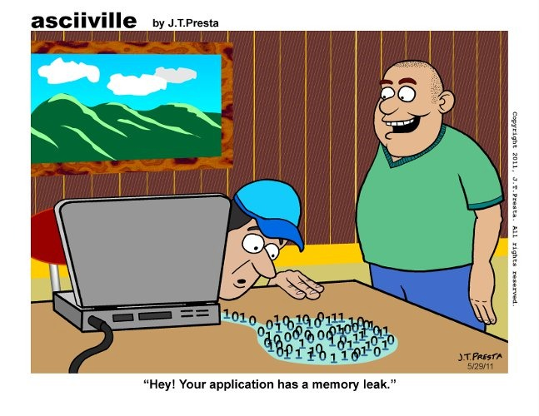
Memory Leaks

Slide 8
Memory Leaks
A memory leak happens when data is stored in memory but cannot be accessed by the running code
This can result in bad performance and even crashing the running process

Slide 9
Memory Leaks
One common cause of memory leak is incorrectly releasing a dynamically allocated array
Recall that to release an array you can use the delete keyword
However, forgetting the [] will result in a delete operation of the first slot of the array instead of the entire array!

Slide 10

Memory Stomps

Slide 11
Memory Stomps
Memory stomp happens when memory are being written unexpectedly by unknown source
There are many ways that can cause this to happen
The two major causes are bad array indices and dangling pointers

Slide 12
Memory Stomps
The index of operator performs an address computation without any error checking
This means the programmer is free to access any part of the memory outside of the bounds of the array
It is up to the programmer's responsibility to check that the indexes valid before accessing any part of an array

Slide 13
Memory Stomps
Another common cause to memory stomps is with dangling pointers
Dangling pointers are pointers that are pointing at memory locations that are no longer valid
For example, when a dynamically allocated address is being deleted, the pointer should be manually set to NULL
Failure to do so can result in new allocations being overwritten by random data

Slide 14

Rule #4 - Divide and Conquer

Slide 15
Rule #4 - Divide and Conquer
Pick a number between 1 to 100, how many guesses will it take for someone to guess it?
This rule is about narrowing the search
In order to do so, there are two very important details:
  You have to know the range of the search
  When you look at a point, you have to know which side of the problem you are on

Slide 16
Rule #4 - Divide and Conquer
Finding the range is easy if you assume that the entire system is the range
This can be a much bigger range than you would like, but it eliminates any assumptions that can potentially make your search longer than it should
Knowing your system helps define the range

Slide 17
Rule #4 - Divide and Conquer
Once your search range is defined, you have to pick a point (e.g. using a breakpoint)
You have to know that at one end things are good (upstream) and at the other things are bad (downstream)
Keep searching downstream and you will eventually close in on the problem

Slide 18
Rule #4 - Divide and Conquer
Sometimes the bug can be subtle and random looking
To make it more obvious we can inject easy-to-spot data or test patterns
In fact, sometimes you might find that there are more than one bug in the system
If so, you need to fix the bugs you know about as you continue the search as it helps eliminate assumptions.

